Slide 1

2022 RP Orientation: Intro to Geospatial Python
Bogdan Mukhametkaliev
Nishka Sharma

Slide 2
Motivation
Without GIS, units of spatial analysis are limited to:
Countries
Administrative units in developed countries (e.g. counties in the US)
Some villages in developing countries
GIS allows to examine any units of spatial aggregation:
administrative units across all countries
all populated territories globally
locations of ethnic/linguistic groups
old kingdoms
artificial units

Slide 3
Motivation cont’d
GIS opens doors to more credible identification:
Control for many geographic covariates
Create instruments (such as distances from certain locations)
Conduct spatial RD-design exploiting historical accidents (e.g. Mita in Peru, Dell 2010)
Test whether a discovered pattern is invariant to spatial aggregation

Slide 4
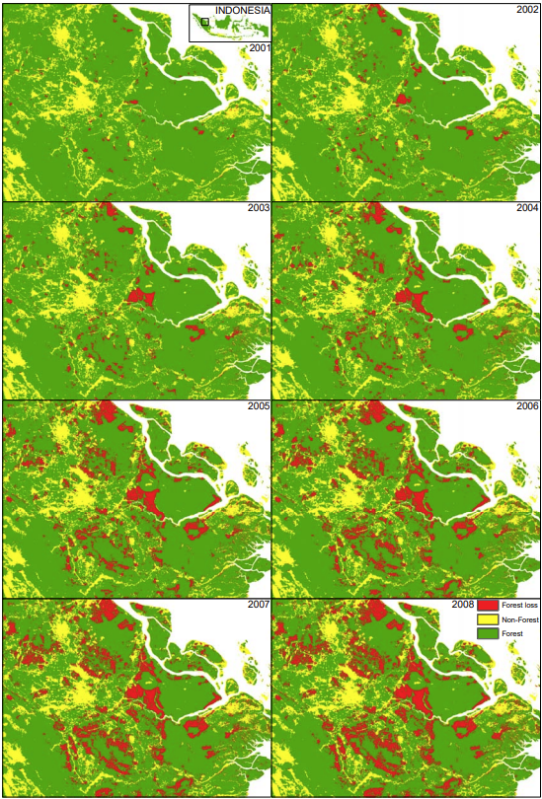
Motivation: Example 1 (satellite data)
Robin Burgess, Matthew Hansen, Benjamin Olken, Peter Potapov, and Stefanie Sieber (2012). “The Political Economy of Deforestation in the Tropics,” QJE 127 (4): 1707-1754.
Tropical deforestation accounts for one fifth of greenhouse gas emissions. Much of it comes from illegal logging.
Burgess et al. use satellite data on changes in forest cover to examine how local officials respond to changing incentives by allowing more or less logging.

Slide 5
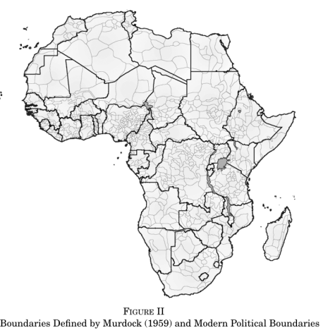
Motivation: Example 2 (old maps)
Nathan Nunn (2008). “The Long-term Effects of Africa’s Salve Trades,” QJE 123(1): 139-176.
Can Africa’s underdevelopment be explained by the slave trade?
Using archival research and GIS techniques, constructs estimates of slavery-intensity at the country-level. Uses these estimates, together with distance-based IV (also constructed with GIS) to show that slavery had negative impact on development among African countries.

Slide 6
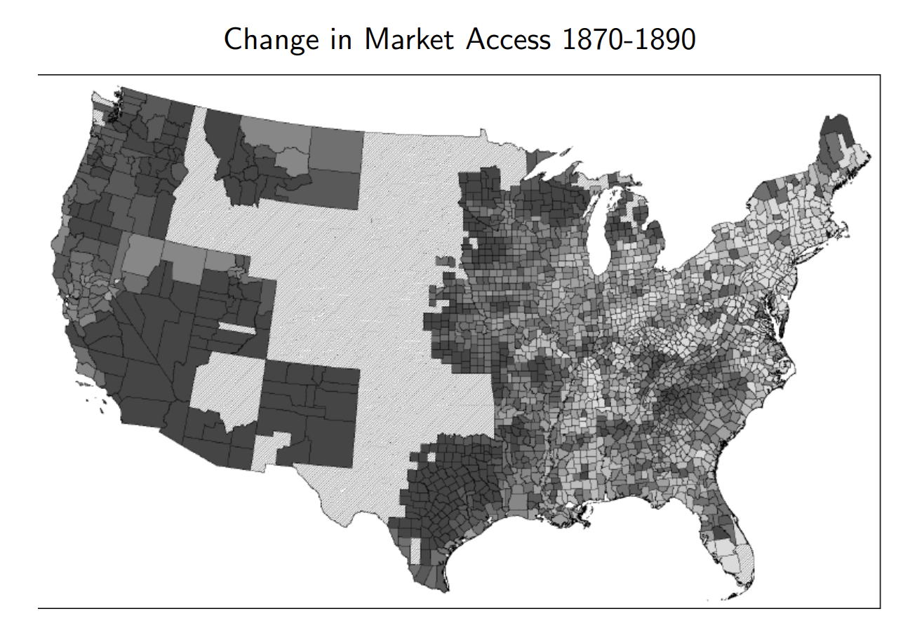
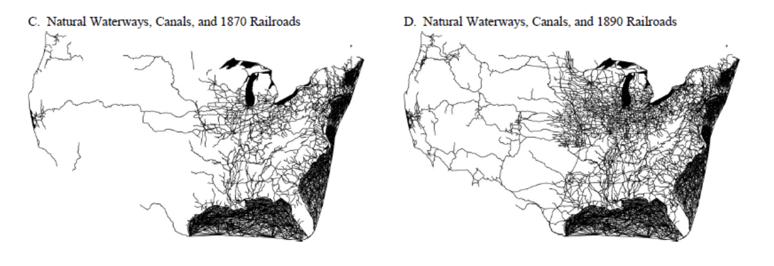
Motivation: Example 3 (network)
Donaldson, Dave and Hornbeck, Richard (2015). “Railroads and American Economic Growth: A “Market Access” Approach” QJE
Evaluate the role of railway construction for US economic growth.
Combine transportation network over time and census data to show that expansion of the railway network fostered both local and aggregated economic growth. Theory-based application of intra-country trade model (Eaton and Kortum, 2002) in a reduced form framework to quantify the spillover effect of infrastructure project. Railways expansion fostered US economic growth. Aggregate effects are considerably larger than local effects (due to higher “market access”).

Slide 7
Introduction to GIS
Most common types of geo-data formats:
Feature (vector) data: shapefiles (.shp)
Polygons
Polylines
Points
Raster (cell) data: raster files (.tif), for example

Slide 8
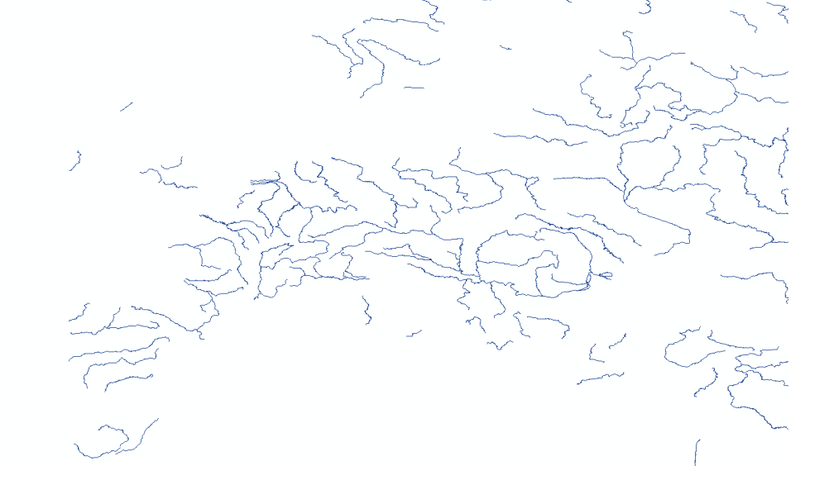
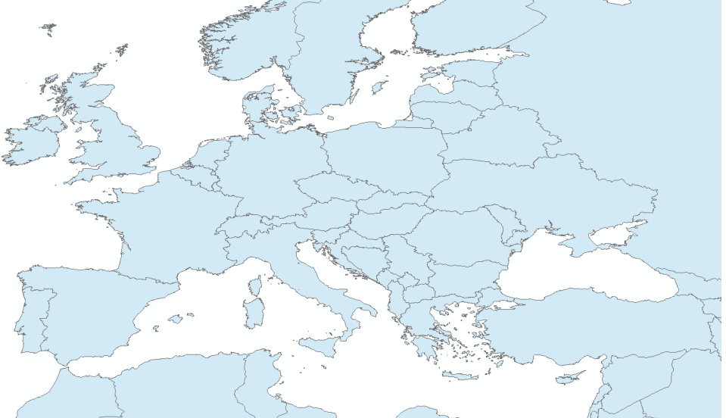
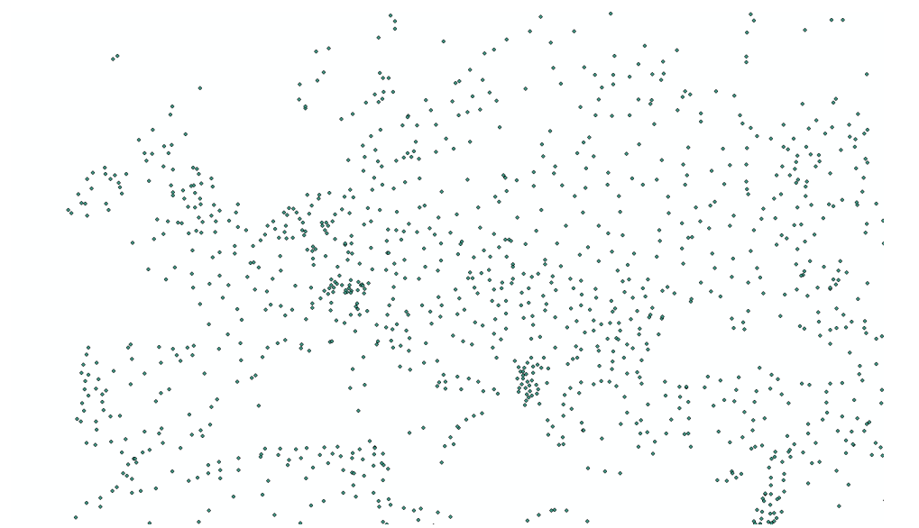
Data Types - Feature
Rivers as polylines
Countries as polygons
Cities as points

Slide 9
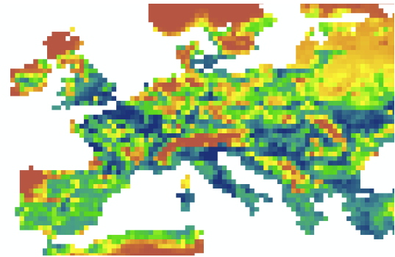
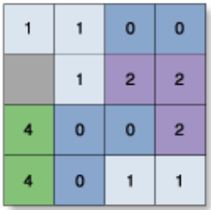
Data Types 2 - Raster
Agricultural suitability in raster format
Each cell in the raster has a value:
Cells can be empty
Data does not need to be integer (e.g. float)

Slide 10
Introduction to GIS – Coordinate Systems and Projection
To view, manipulate, and make calculations with geo-date, the geographic identifiers need to be referenced with respect to a coordinate system.
Each coordinate system represents the Earth’s sphere (or its part) in two dimensions
WITHOUT USING AN APROPRIATE COORDINATE SYTEM, YOUR CALCULATIONS ARE MEANINGLESS!!!
Two basic types of coordinate systems:
Geographic coordinate systems
Projected coordinate systems

Slide 11
Coordinate Systems - Geographic
Geographical coordinate systems represent locations in spherical coordinates
Two ways to encode geographic coordinates:
Degrees, minutes, and seconds
Chicago is 41° 52' 54.5952‘’ N, 87° 37' 23.4372'' W
Decimal degrees
Chicago is 41.881832, -87.623177
The standard geographic coordinate system is the World Geodetic System (WGS) 1984.
For distances between two points along Earth’s surface, we can use geodesic distance formula: need only ((lat1, lon1), (lat2, lon2)).
BUT: geographic coordinate systems are useless for calculating areas and distances along lines
1˚ longitude is 111.3 km at the equator but 55.8 km at 60 ˚ N/S

Slide 12
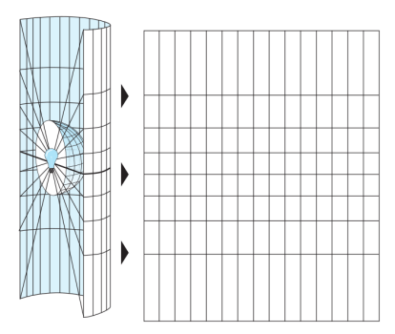
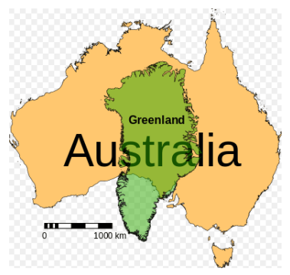
Projected Coordinate Systems
One can think of shining a light, placed on the center of the earth, through the earth surface, and casting a shadow on a projection surface of a certain shape
Note stretching of data near the poles

Slide 13
Other Projections - Summary
WGS 1984
For distances between two points
UTM
Divides the surface of the Earth into many regions, each gets its own projection
For distances and areas in small regions
For lengths of polylines
Any equal area projection
For areas in large regions

Slide 14
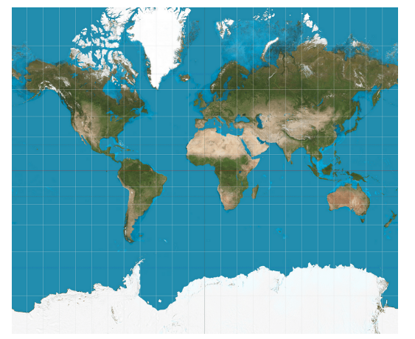
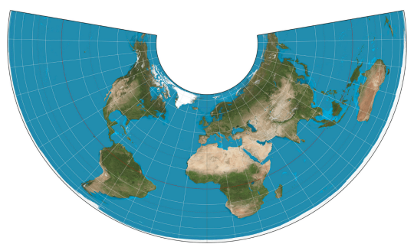
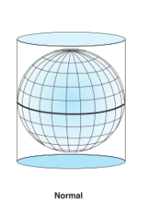
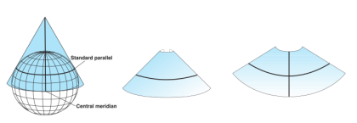
Albers Equal area conic projection
Mercator projection

